Slide 1
Phase 3 Water Quality Analysis
Ibm congos analytics

Slide 2
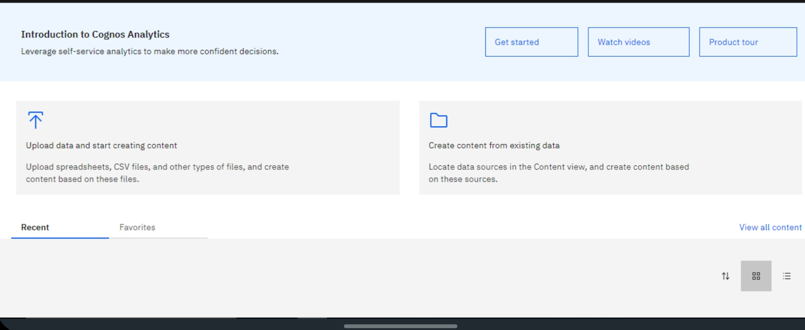
IBM CONGOS ANALYTICS: Create a account

Slide 3
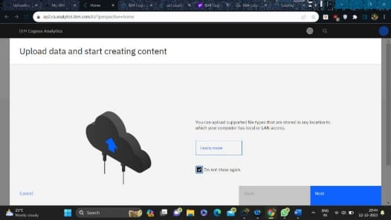
Dataset Loading and Preprocessing:
Loading or Uploading Dataset: • In this phase of the project we are going upload our dataset for analysis which is already provide through Kaggle link in the SkillUp platform. • For this purpose, first of all we have to access to the IBM Cloud services and IBM Cognos Analytics suit. • All must create a IBM Account and register as lite account for gaining access to the some premium membership accessibilitie

Slide 4
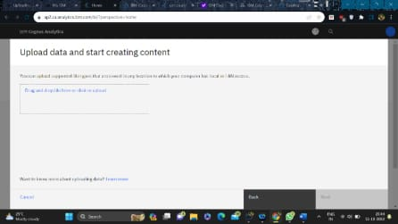
• A Lite account can use the features of IBM software of web applications upto a certain limits in time period , no.of sessions per month,storage limits etc. • After the account is created and accessibility gained we have create a project and Upload our Dataset that need to be analysed into the My Conents section. Using selecting from storage option or drag and drop option.

Slide 5
Preprocessing Dataset:
• Clean the data by handling missing values , outliers , and data quality issues. • Transform and reshape the data as needed . This might include feature engineering , data aggregation ,or other data preparation.
• Data Preprocess is one of the crucial step in the Data Analytics . Otherwise our analysis can be irrelevant due to unwanted noises in the data. • This includes null value removal , formatting ,etc.

Slide 6
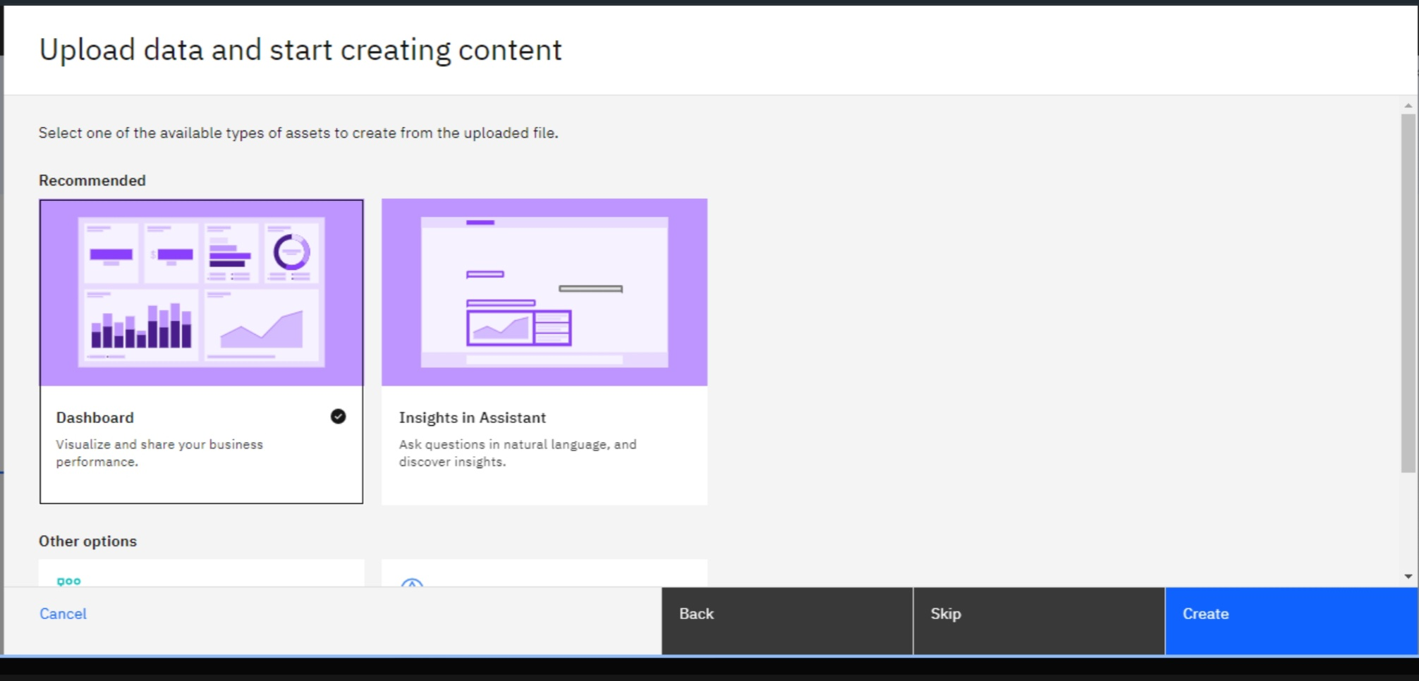
Basic Analysis and Visualization (Dashboard Creation):

Slide 7
Analysis: • Use IBM Cognos for descriptive and exploratory data analysis. Conduct statistical analysis to understand the dataset's characteristics. • Identify patterns, trends, and correlations within the data. Look for potential factors that may contribute to website traffic analysis.

Slide 8
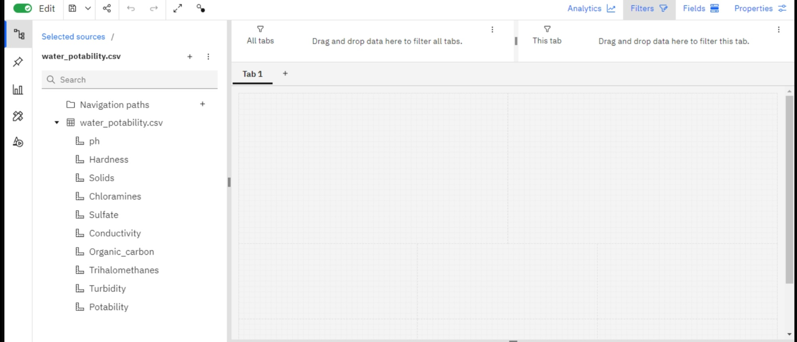
Visualization:
• Create visualizations using IBM Cognos to present your findings. This might include: • Histograms, scatter plots, and box plots to visualize data distributions and relationships. • Line charts or time series visualizations to explore trends over time. • Dashboards that summarize key insights in a user-friendly manner.

Slide 9
